Slide 1
Date-A-Scientist Project
Machine Learning Fundamentals
Richard Joseph (cohort sep. 18, 2018)
November 18, 2018

Slide 2
Table of contents
The idea and the questions to be answered
Exploration of the dataset
Augmenting the dataset
Regression Approches
Classification Appoches
Conclusion

Slide 3
The idea and the questions to be answered
Right now in North America we seems to have a big opioid (and other drugs in general) epidemic. We also see that we have a lot of underage drinking. I remember an old saying : “When you grow old, you get wiser…” But is it true? Do we party and drink all the time when we are young but getting older we sober up? Having those things in mind, we thought that we could try and answer the following questions:
1- Can we predict our drug habits only based on the person age?
2 – Can we predict the age of someone based on their drinking and drugs habits?

Slide 4

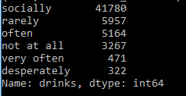

Exploration of the dataset
Now that we now what we are looking for (a relation between age, drinks and drugs), let take a look at those data. First let’s look at “.value_counts()”; this function will give us some hindsight on the type of value each feature can have and how many time they are showing. You can see on the left the ones for drinks and drugs (the one for “ages” is simply too long, but trust us we did it). Here we have a quick count of the different labels for both of them. For the age value, the ages are between 18 and 110. We also use “.head()” to have a look at how the data was arranged.

Slide 5
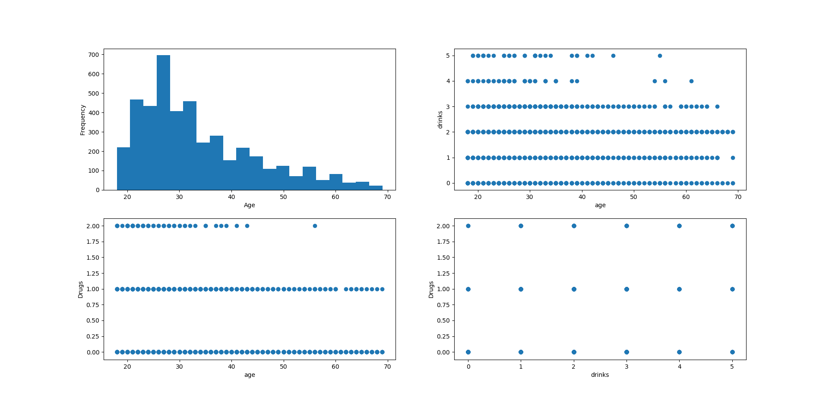
Graphic 1 – age frequency / age VS drinks / age VS drugs / drinks VS drugs

Slide 6
On the previous figure, you can see that we took a look at several columns and verify if there were some correlation between them. Looking at the data, here are the observations we made:
All ages are between 26 to 69, with 2 odd one at 110 and 109 years old. The mean being 32.34 year old (calculated using “df.age.mean()”).
Most of the people on this website are between 26 to 28 years old.
There is a slight correlation between the age and how often they drink or if they take drugs
The graph drugs vs drinks don’t give us any info at all!

Slide 7
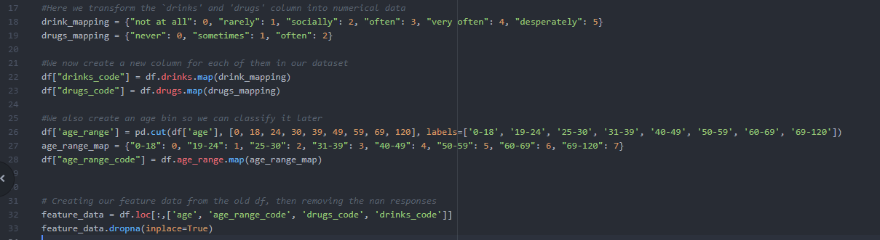
Augmenting the dataset
We created 3 new columns: age_range_code drinks_code and drugs_code. We needed to make sure that we could use drinks and drugs (both categorical data) in our feature and we needed to transform age to be categorical for the 2nd part of our test. To change those categorical data to numerical label, we mapped each of them using “.value_counts()” to have all the possible values for them (see slide 4). After that, we use the “.map” function to map all the codes in our new columns. To finish, we created a new dataset with only the data we would need and removed all “NAN” data

Slide 8
We also use the “.bin” function of panda to create different labels for our age groups: '0-18', '19-24', '25-30', '31-39', '40-49', '50-59', '60-69', '69-120’. With this column created, we will be able to use “age_range_code” as a label.

Slide 9

Regression Approches
So the first question we want to answer is: Can we predict our drugs habits only based on the person age?
Since all our data are labeled, it is simple to say that we are only looking at Supervised learning to tackle those questions (thank God!) and since we are trying to find a real number out of one feature, we will use a Regression approche first.

Slide 10

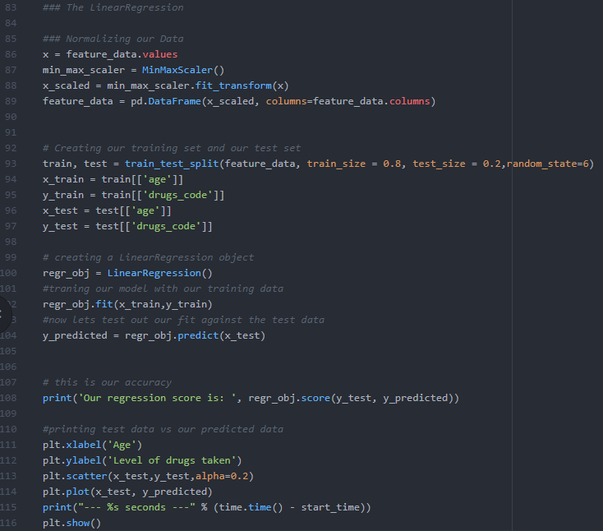
Since we are searching for a correlation between the output variable (the age) and an independent feature, the most promising technique here “should” be the Multiple linear Regression. The advantages we would get using this technique are:
this method is fast to model and write
easy to understand
somewhat good accuracy (normally with data that have a good relationship with each other)
The time it took to run this model was around 2.094 seconds; this time could vary depending on how many features we have to evaluate (let say age and drinks), how many features we need to first translate into numerical data and how much data we have. Since we are only doing Age VS drugs it was fairly quick. And since accuracy_score is for classification only, we used the “.score()” method to calculate our accuracy. We got “-0.038096” which is not accurate. It seem that our model doesn’t follow the trend of our data.

Slide 11
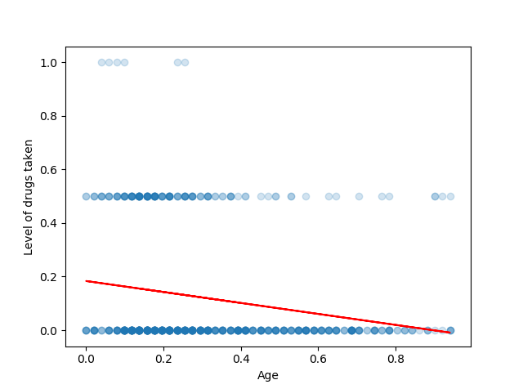
The image on the left if the result of our Linear regression. We see here in blue the test data, and in red the predicted regression. One of the disadvantages of this method is the fact that we don’t have any parameter to force the model to fit better on the data.

Slide 12
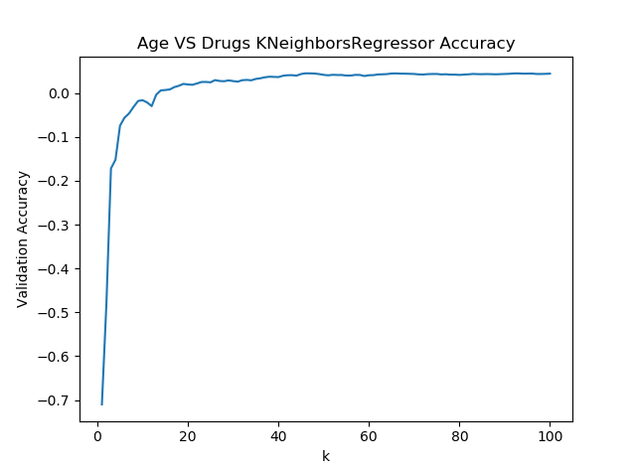
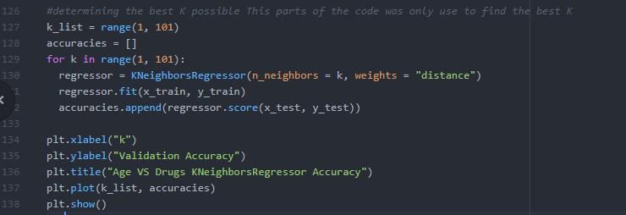
To compare, we also used the K-Nearest Neighbors Regression. Since we are looking to find out if we can predict the drugs usage using the age as feature, will with try to first figure out what would be the best K. Looking at the figure below, you can see the code I used to create the plot of the best K. we can see that using a range of k from 0 to 100, there is no “clear winner” (they are almost all under 0, see plot on the right).

Slide 13
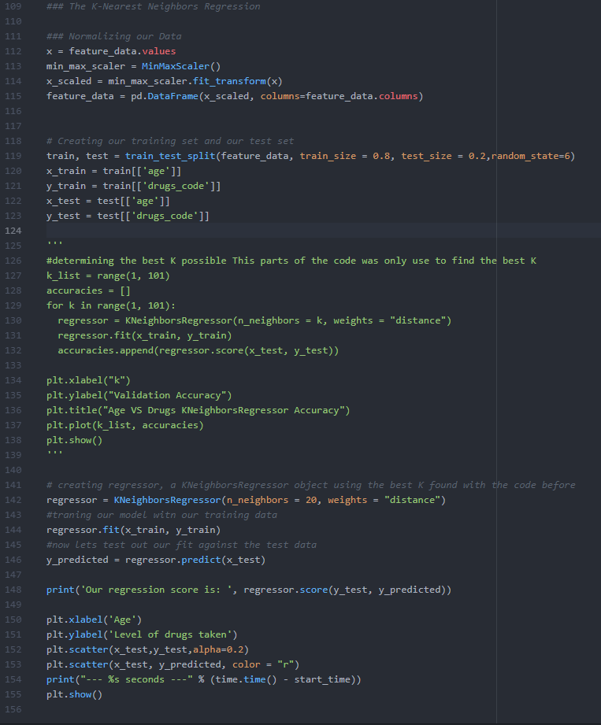
For this run, we will use 20 neighbors. That K might help us better predict the group of people with similar feature that are more likely to take drugs.
The advantages of this technique are:
As fast and easy to code as the linear regression
No need to know the shape or deep characteristics of the data before end
Work well with a lot of data
As at least one parameter to try and fit the model on the data.
The biggest drawback that we see for this method is “the search for the perfect k”; even more when the data is very big. Having to go through hundreds or even thousands of k could potentially be very time consuming. In this instance, we choose a K of 20 and it gave us a score of -1.33367 with a running time of 2.1050 seconds, showing once again that our model doesn’t follow the trend of our data. But again, it was as fast as the linear regression. Both model are very similar in implementation and resource needed by the pc.

Slide 14
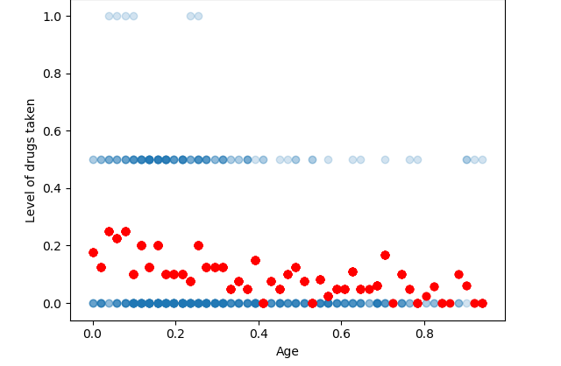
The image on the left if the result of our K-Nearest regression. We see here in blue the test data, and in red the predicted regression. We can see that our predicted values are not even near the y maximum of the test set.

Slide 15
Classification Appoches
Seeing our failure with the regressions, we will now try the classification. But we will try to answer our second questions here: Can we predict the age of someone based on their drinking and drugs habits? The two classification techniques we thought of using are the Support Vector Machines and the K-Nearest Neighbors classifier. We will use the “age_range_code” value we create so we can properly classify the “age” (we did try without this step and we got the error “ValueError: Unknown label type: 'continuous'”).

Slide 16
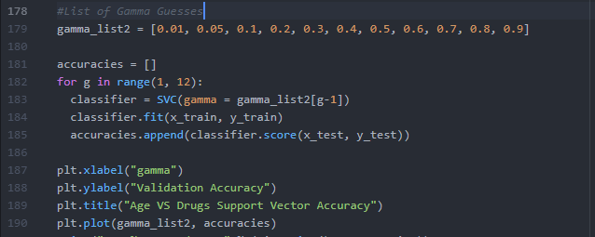
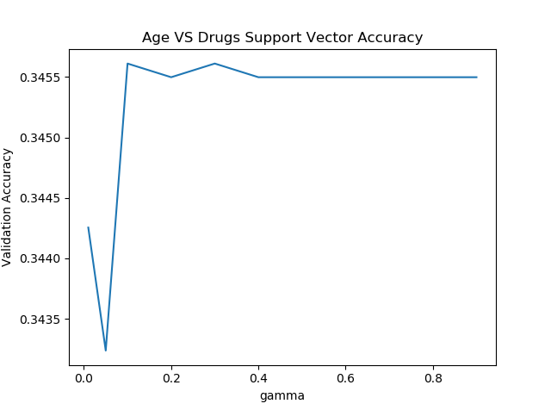
Stating with Support Vector Machines, we rapidly realise that it takes a lot more time to run a classification code than a regression. When we were searching for the perfect gamma and C parameter for our classifier, it took 517.8069 seconds for our code to go through 11 different gammas (see code on the top of the page)! Looking a the image on the left, the best gamma would be 0.1. Another drawback for this method is the fact that we have to guess a good gamma AND a good C for it to perform well. Guessing through 30 different Cs took 1575.6970 seconds!

Slide 17
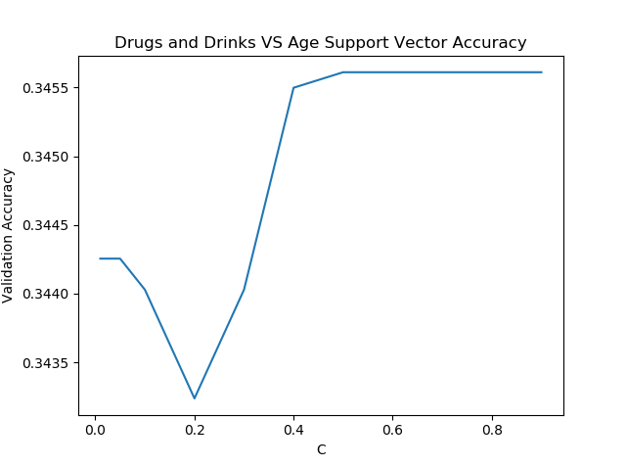
Modifying the code on the previous page but making the C parameter change, we found out that the best C was 0.4 (see figure). Using this new knowledge, we can now test the actual model.

Slide 18
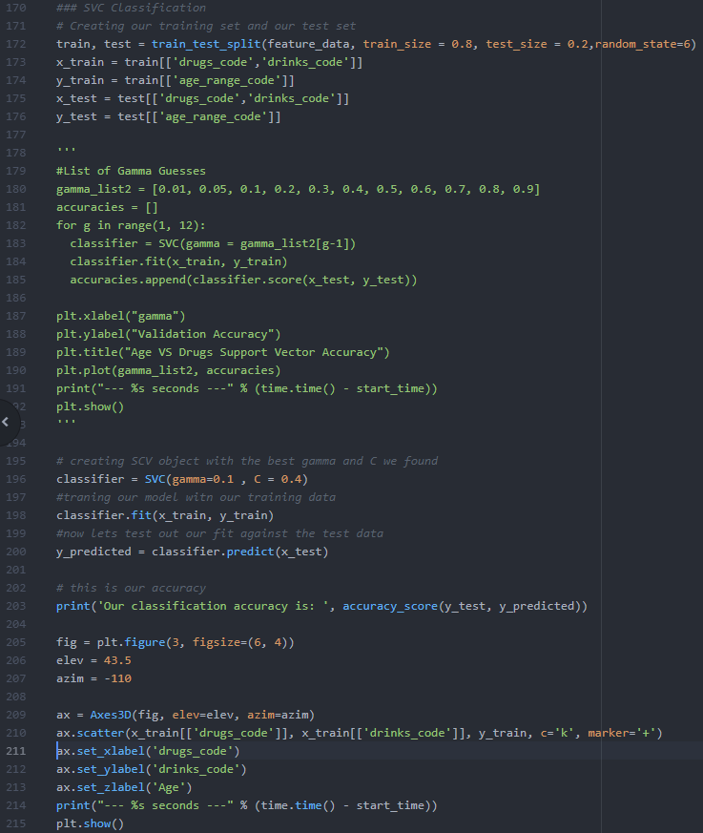
Using those parameters, we get an accuracy of 0.345 or 34.5% which is very low, but way better than our regression test! We spoke about the disadvantages of the Support Vector Machine before, but lets talk about the advantages of SVC. With the big versatility of this method, we can adapt the Kernel to a lot of different types of data (“linear”, “poly“ or “rbf”). Also, having found the right gamma and C for our dataset results in some better accuracy.

Slide 19
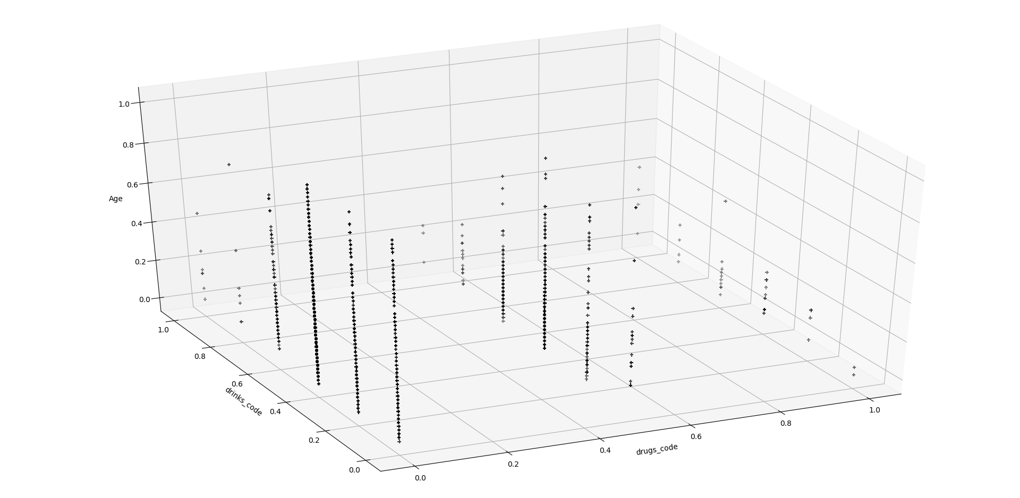
See below for a 3d graph of drugs VS drinks VS age test data for both classifications

Slide 20
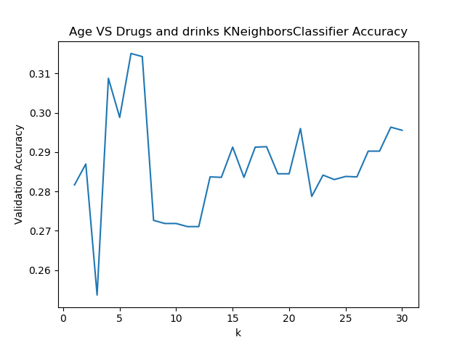
Now let’s try and use the K-Nearest Neighbors Classifier on our dataset. The first thing we did here, like for the previous method, was to fine tune our K (our number of nearest neighbors) using our training group. After going though a range of 1 to 30 in only 53,3080 seconds, we found out that the best K was about 6 (see graph on the right). Using this K in our code (see next page), we are able to get an accuracy of 0.315105 or 31.5105%, with a run time of 3.6870 seconds!

Slide 21
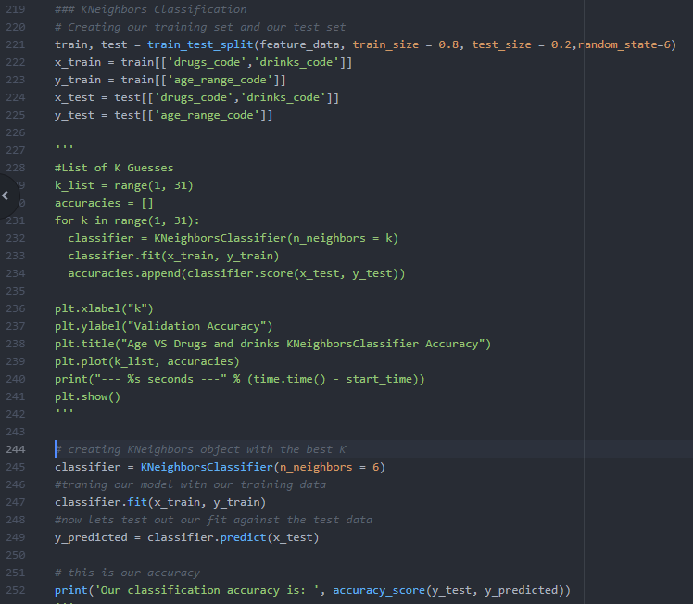
So this method was less accurate than the SVC Classification but was way faster. Also, we only had to play with one parameter, which was simpler.

Slide 22
Conclusion
What did we got out of all this?
Well, for our specific dataset, the most accurate method was the SVC Classification but was the slowest. The Fastest was linear regression, getting almost beaten by the k-nearest regression, but both had horrible accuracy. K-Nearest Classification was fast and somewhat accurate. We can see that for any given question, it has great potential to try out different method since none of them are a “one-glove-fit-all”. Before starting this project, we thought that the best one would be by far the linear regression! We were very disappointed.

Slide 23
So, were we able to answer our questions?
Not reliably. Our best prediction accuracy was of 34%, which is seriously low. One thing that we do have to kept in mind is our data; can we trust it? We all know that on a dating site, we want to look our best, and because of that we will “adjust” our reality. We are pretty sure that a lot of participants lied on their drug usage and drinking habit, which in turn might have impacted the end results. On a next run, we would like to include more feature to try and predict the age, like adding if the person smokes, have an healthy diet and even their body type, because who would lie on their body type, right?

